Slide 1
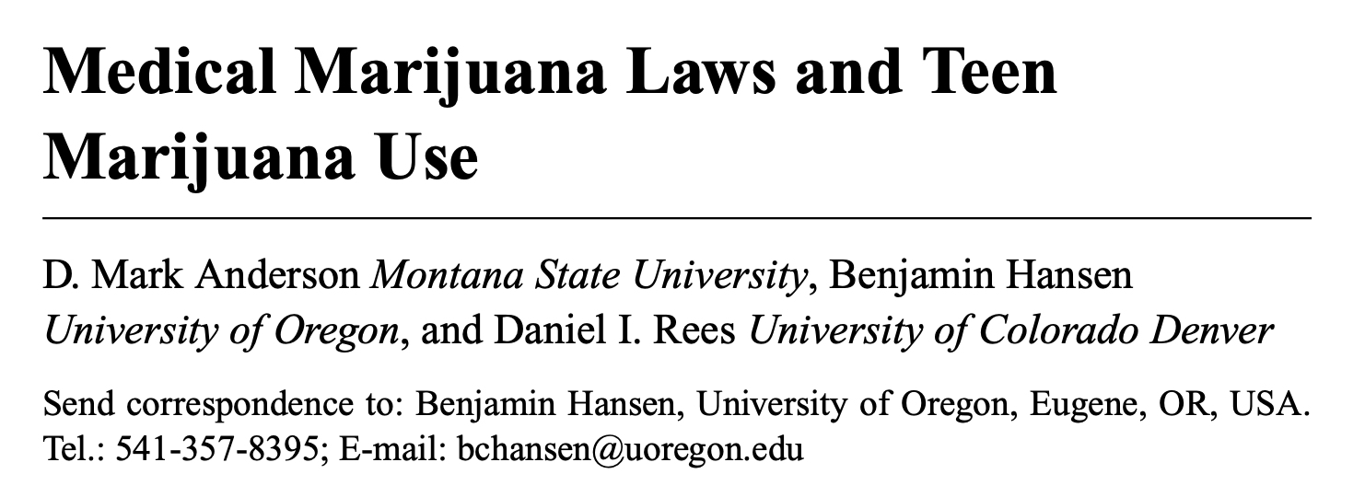
Presented by Paul George, Nov 2023

Slide 2
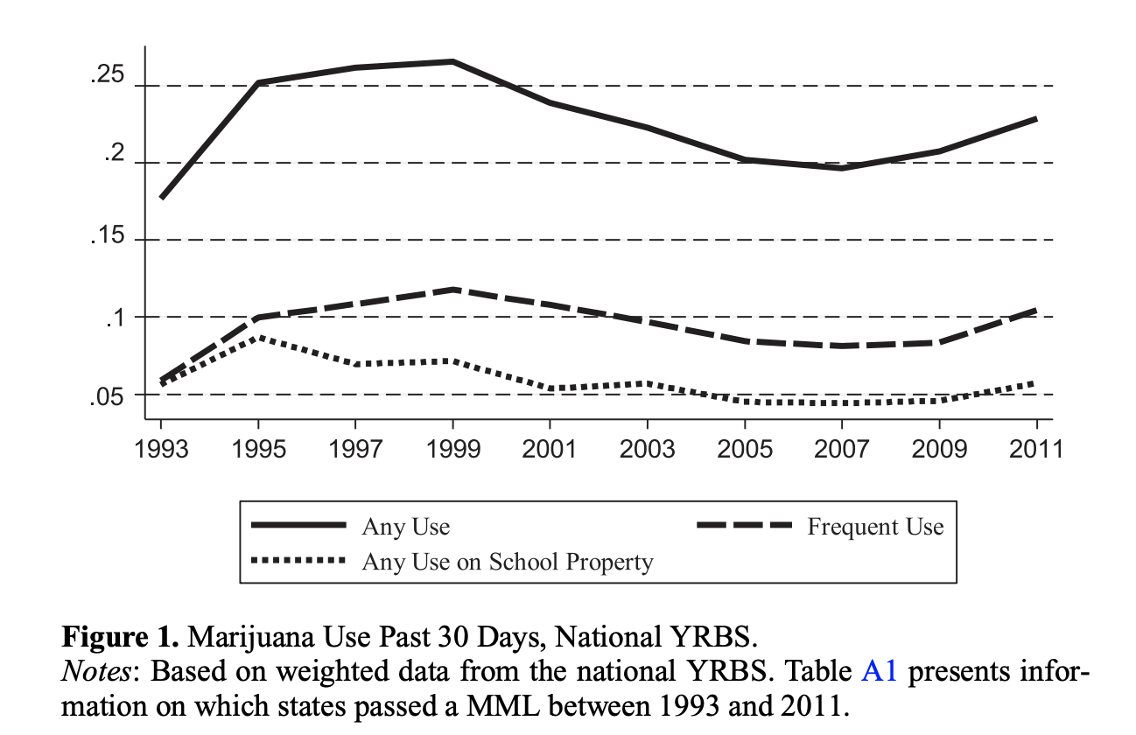
Principal hypothesis/point of paper
Policy makers and law enforcement officials argue that medical marijuana laws (MMLs) “send the wrong message” to young people, increasing marijuana use
Is this true?

Slide 3
Why is this topic important?
Marijuana industry, both medical and otherwise, is growing
Does growing acceptance of marijuana increase marijuana use in teenagers?
Notes:
He doesn’t really address this in the paper
Especially preventable mortality

Slide 4
What is the contribution of the article to the literature?
Previous work has found little or no contribution of MML to marijuana use
Anderson contributions:
1. Use data from 1993-2011, a period during which 16 states and D.C. legalized medical marijuana
2. First study to include pre and post legalization in California
3. Individual level (as opposed to aggregate) data
4. Data on marijuana use and availability at school
Notes:
School is especially relevant given efforts to close dispensaries near schools

Slide 5

Theory
$$P\left(MarijuanaUse\right)=f\left(cost, punishment, availability, SocialNorms, PerceivedRisk, PersonalAttitude\right)$$
Legalization of medical marijuana impacts social norms and personal attitudes

Slide 6
Data used
Youth Risky Behavior Surveys (1993-2011)
Both state and national
Conducted biennially (every other year) by CDC, nationally representative sample of US high school students
During this period, 16 states legalized medical marijuana
National Longitudinal Survey of Youth 1997
Panel data
Treatment Episode Data Set
Information from drug treatment providers on patients who reported using marijuana before being admitted

Slide 7
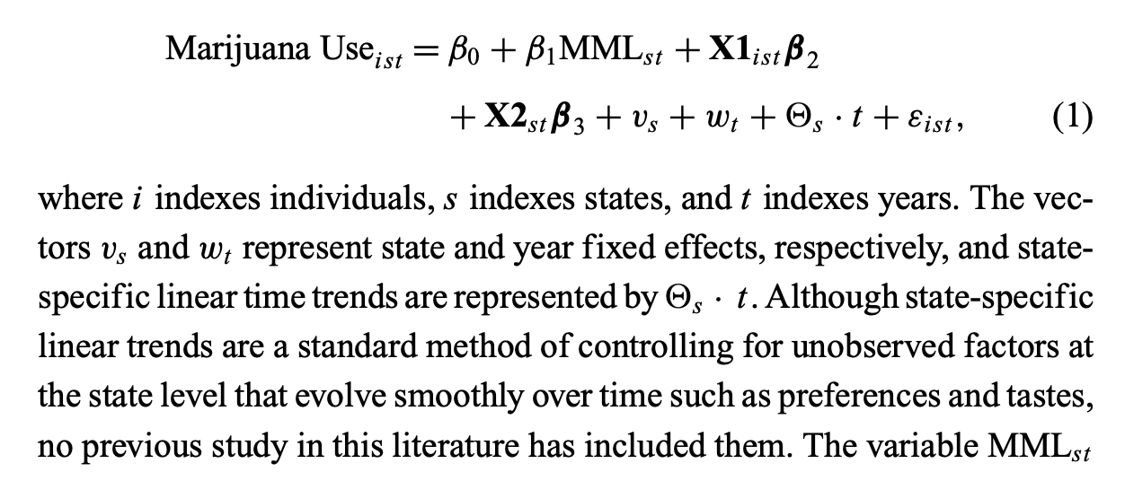
Methods (part 1)
State specific linear time trends is an interesting addition

Slide 8
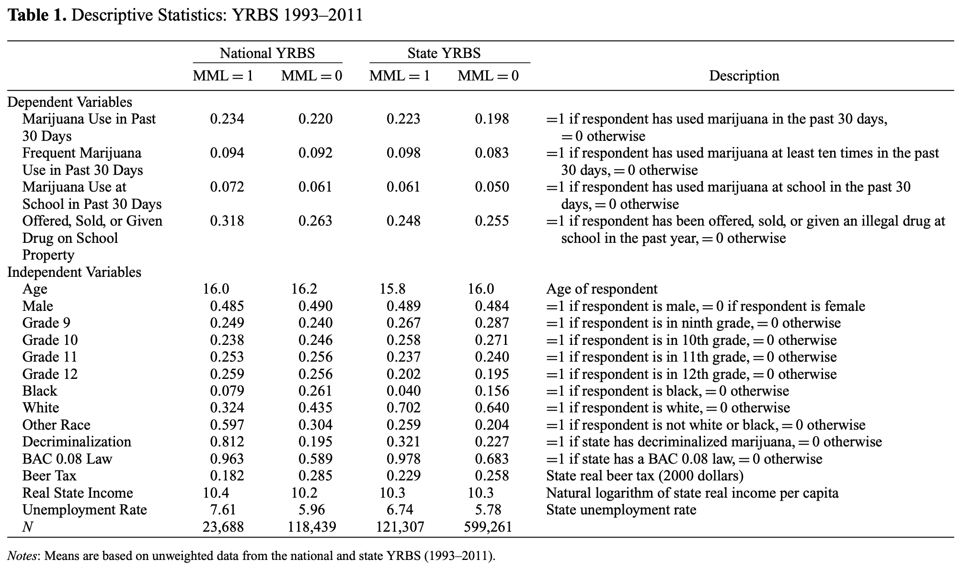
Results (Table 1)

Slide 9
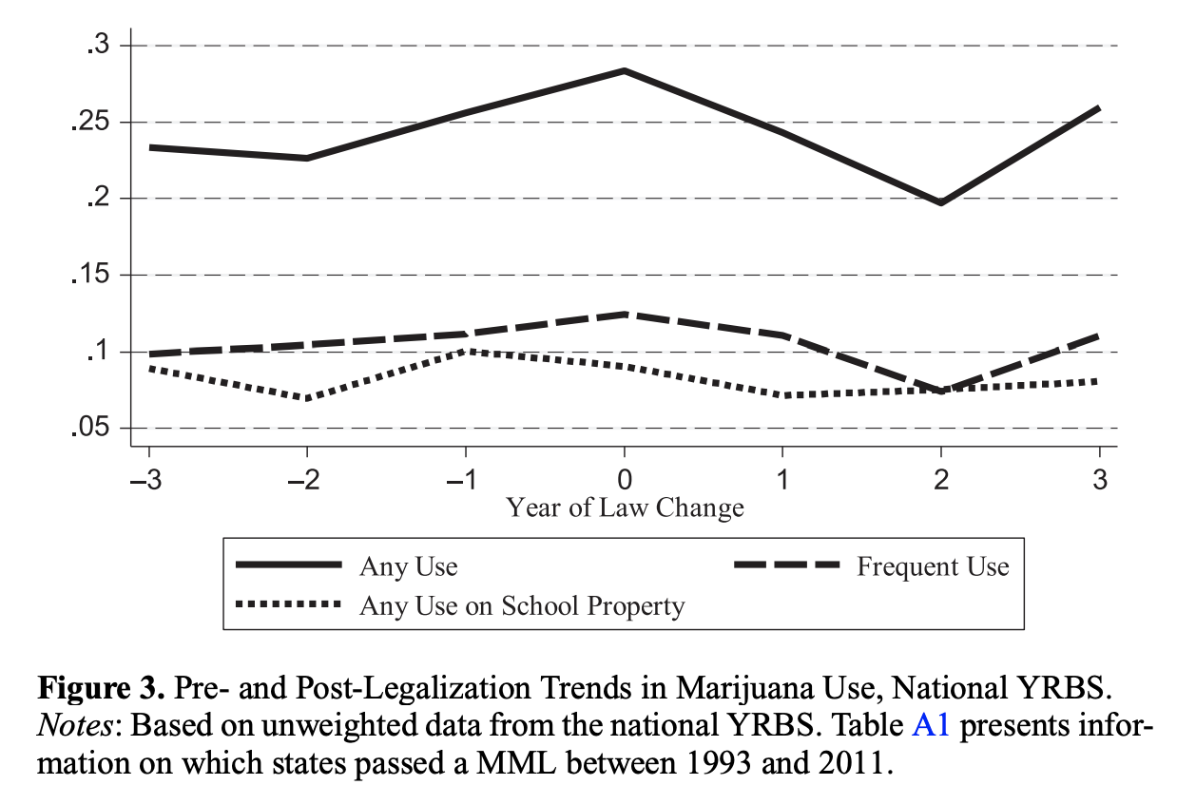
Results (Figure 3)

Slide 10
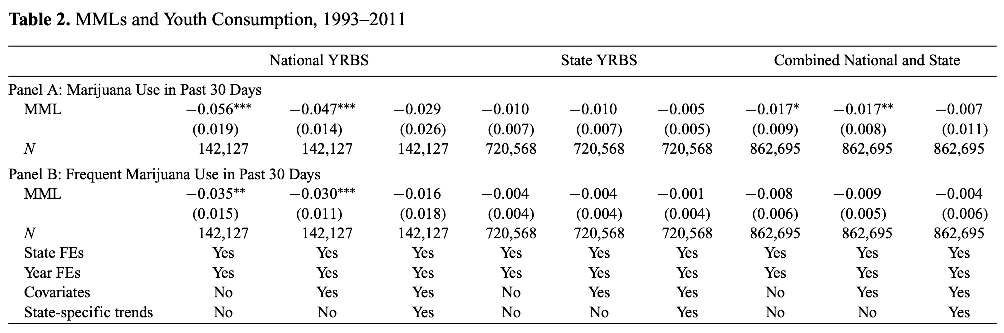
Results - Main model
Red circles = author’s preferred model
Interesting how inclusion of the state-specific trend impacts the results
Notes:
Dependent variable is the natural logarithm of the death rate
Independent variable is state unemployment rate

Slide 11
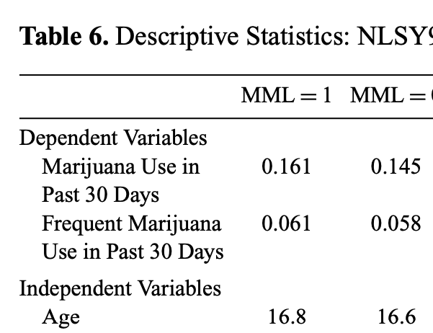
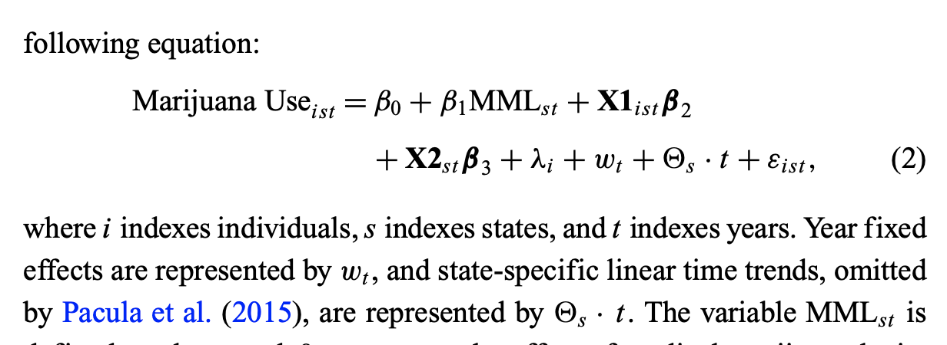
Methods (part 2 – using NLSY97)
Note the individual fixed effect, ƛi
“these effects account for factors at that state level that may be correlated with marijuana use and the legalization of medical marijuana”

Slide 12
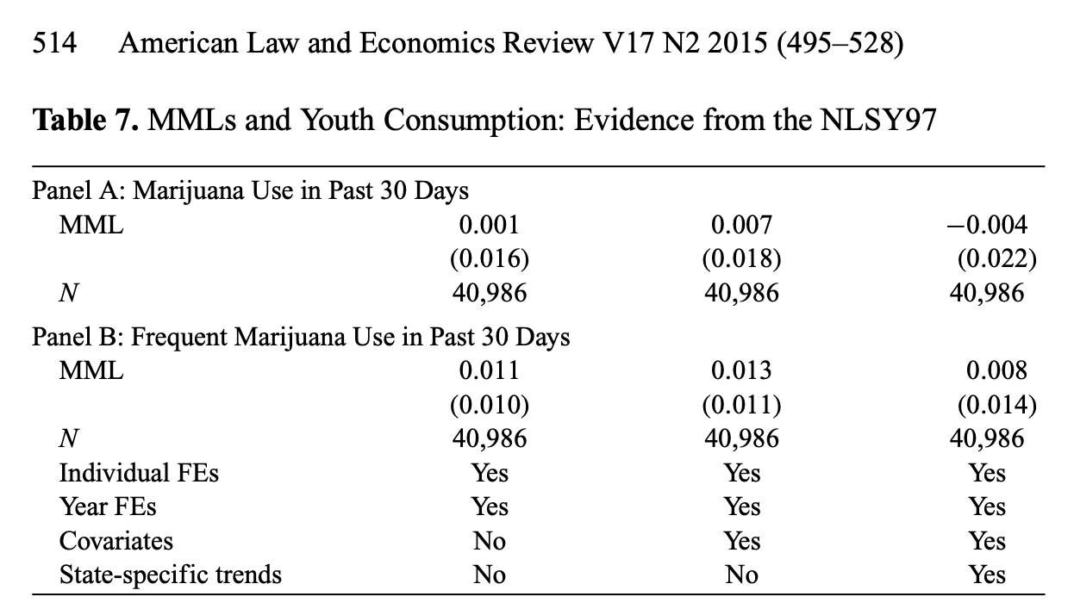
Results – NLSY97
Red circles = author’s preferred models
Interesting how inclusion of the state-specific trend does not impact the results
Notes:
Dependent variable is the natural logarithm of the death rate
Independent variable is state unemployment rate

Slide 13
Main conclusion
Results are not consistent with the hypothesis that legalization of medical marijuana caused an increase in the use of marijuana among high school students
A one percentage point rise in the state unemployment rate, relative to its historical average, is associated with a ~0.5-0.6 percent decrease in total mortality (~11,000 fatalities annually)

Slide 14
Commentary
Reverse causality
Individual level data, so no!
Omitted variables
Impact both state MMLs and individual teen use?
Trouble with survey data
Though, I would have expected people living in states with MMLs to be more likely to report marijuana use (conditional on using), given social desirability bias
Nice to see null results published
I think his significant, negative effects are interesting – could increase in legal marijuana via dispensaries actually decrease teen use?

Slide 15
New research ideas
Has legalization of recreational marijuana increased teen use?
Have dispensaries moving into neighborhoods (including school neighborhoods) increased teen use?
Have dispensaries moving into neighborhoods and/or marijuana laws impacted patients with chronic pain?
Has legalization of psychedelic medications (e.g., MDMA, psilocybin) increased teen use?

